Slide 1

A Presentation of Major Project on MEDICAL REPORT ANALYSIS SYSTEM
Himalaya College Of Engineering
Affiliated to Tribhuvan University
Supervisor: Er. Pratap Sapkota
Presented by :
Prabesh Kumar Shrestha (070/BCT/32)
Praveen Dhungel (070/BCT/33)
Sahit Baral (070/BCT/41)
Season Maharjan (070/BCT/48)

Slide 2
OVERVIEW
Introduction
Objectives
Features
Requirements
Development Platforms
System Overview
Methodology
Advantages
Algorithms
Conclusion
Future enhancement
References
Screenshots

Slide 3
INTRODUCTION
Android Mobile Application
Application with custom Optical Character Scanner
Application to analyze the medical report with ease
Processes the digital image
Provides a basic analysis of medical report’s value
An easy way to review medical report from home or office

Slide 4
OBJECTIVES
To use the smartphone technology in the field of health
Fulfill the gap between medical field and technology
To be able to read the medical report
To target the normal people for the use of the applications

Slide 5
FEATURES
Custom Optical Character Reader
Processes the digital images
Provides a basic review on the medical report’s values
Medical tool like BMI calculator also included
Emergency call function directly available within the application

Slide 6
REQUIREMENTS
Android mobile with camera resolution minimum 5 Mpx
Storage of minimum 100 Mb
RAM of 512 Mb
Android version- minimum Jelly bean
Processor- Dual core or above
Internet facility and a SIM card

Slide 7
DEVELOPMENT PLATFORM
Android Studio
Firebase
Adobe Photoshop

Slide 8
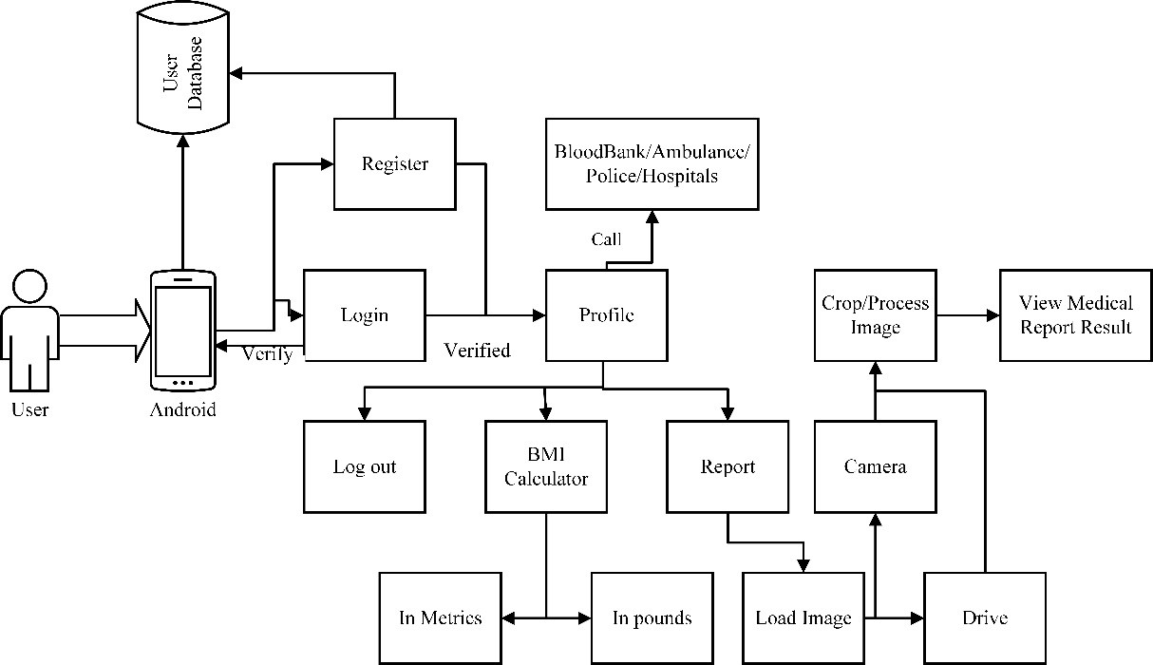
SYSTEM OVERVIEW System Diagram

Slide 9
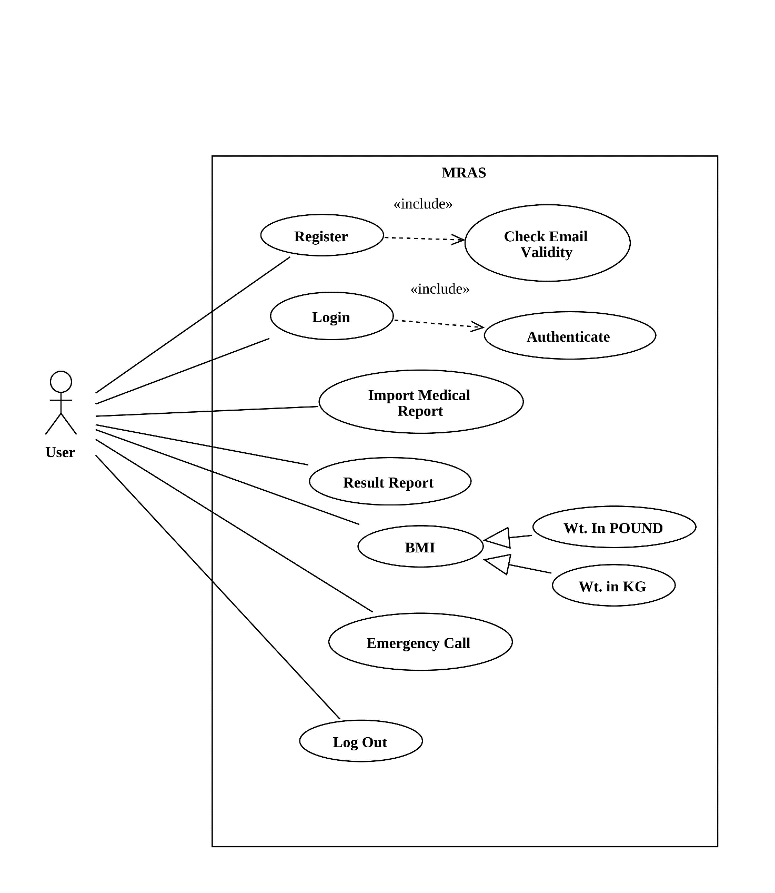
Use Case Diagram

Slide 10
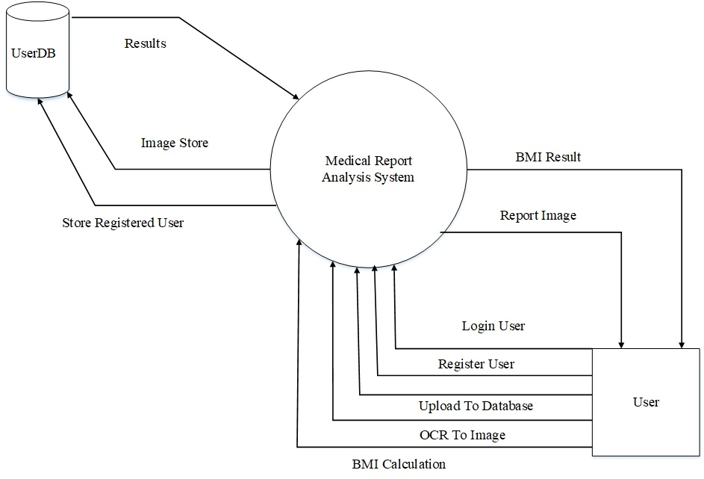
DFD level 0

Slide 11
METHODOLOGY
OCR
Pre-processing
Character recognition
Post-processing
Agile methodology

Slide 12
OCR
PRE-PROCESSING
Remove positive and negative spots, smoothing edges
Binarisation – a simple way of separating the text from the background.
Layout analysis – Identifies columns, paragraphs, captions, etc. as distinct blocks.
Line and word detection – Establishes baseline for word and character shapes, separates words if necessary.
Character isolation or "segmentation"
Normalize aspect ratio and scale

Slide 13
Contd…
CHARACTER RECOGNITION
Matrix matching- comparing an image to a stored glyph on a pixel-by-pixel basis; it is also known as "pattern matching“
Software such as Cuneiform and Tessaract use a two-pass approach to character recognition. The second pass is known as "adaptive recognition"

Slide 14
Contd…
POST-PROCESSING
OCR accuracy can be increased if the output is constrained by a lexicon – a list of words that are allowed to occur in a document
Tessaract uses its dictionary to influence the character segmentation step, for improved accuracy.

Slide 15
AGILE METHODOLOGY
At a high level, non-Agile projects allocate extensive periods of time for Requirements gathering, design, development, testing, before finally deploying the project.
Agile projects can have one or more iterations and deliver the complete product at the end of the final iteration.

Slide 16
ADVANTAGES
Helps to scan and analyze the medical reports
Calculates the Body Mass Index according to western and eastern way
Emergency numbers like blood bank, red cross, Ambulance and hospitals can be called within the application

Slide 17
ALGORITHMS
Tesseract
Linguistic analysis
Adaptive classifier
PageRank
PageRank is a link analysis algorithm
Based on Web graph
C 4.5
Extension of ID3 algorithms
Used for classification (Statistical classifier)
Also uses entropy for building decision tree

Slide 18
TESSERACT
Tesseract is a commercial quality OCR engine
Linguistic analysis-
to identify the most likely word formed by a cluster of characters
Adaptive classifier-
employs training data which is better at distinguishing between upper and lower case letters

Slide 19
PAGE RANK
PageRank is a link analysis algorithm
Based on Web graph
used by Google Search to rank websites in their search engine results
PR (A) = (1-d) + d (PR (T1)/C (T1) + ... + PR (Tn)/C (Tn))
PR(A) is the PageRank of page A,
PR(Ti) is the PageRank of pages Ti which link to page A,
C(Ti) is the number of outbound links on page Ti and
d is a damping factor which can be set between 0 and 1.

Slide 20
C 4.5
Extension of ID3 algorithms
Used for classification (Statistical classifier)
At each node of the tree, C4.5 chooses the attribute of the data that most effectively splits its set of samples into subsets enriched in one class or the other
The splitting criterion is the normalized information gain (difference in entropy)

Slide 21
CONCLUSION
Learned about developing OCR
Developed an android application for medical report analysis
Developed the BMI calculator
Calling function within the application

Slide 22
FUTURE ENHANCEMENT
Better Suggestion to the user
Medical Dictionary
More User Friendly
Recommendation system
Coverage of all medical fields

Slide 23
REFERENCES
[1] Z. Huang, X. Lu, H. Duan, and C. Zhao, “Collaboration-based medical knowledge recommendation,” Artif. Intell. Med., vol. 55, no. 1, pp. 13–24, May 2012.
[2] “Mayo Clinic.” [Online]. Available: http://www.mayoclinic.org/. [Accessed: 11-Dec-2016].
[3] S. Arora, D. Bhattacharjee, M. Nasipuri, D. K. Basu, and M. Kundu, “Combining Multiple Feature Extraction Techniques for Handwritten Devnagari Character Recognition,” ArXiv10054032 Cs, May 2010.

Slide 24
Contd…
[4] A. Purohit and S. S. Chauhan, “A Literature Survey on Handwritten Character Recognition.”
[5] Edward P Hoffer, Mitchell J Feldman and Richard J Kim “Explains patterns of use of a mature expert system” AMIA Annual Symposium Proceedings Archieve.”
[6] Available: http://www.cs.cmu.edu/~javabayes/Home/node2.html (Referred on 14 Dec, 2016)
[7] Herk, Egbert Van. A diagnostic decision support system. Amsterdam: Drukwerk, 19 January 1994.

Slide 25
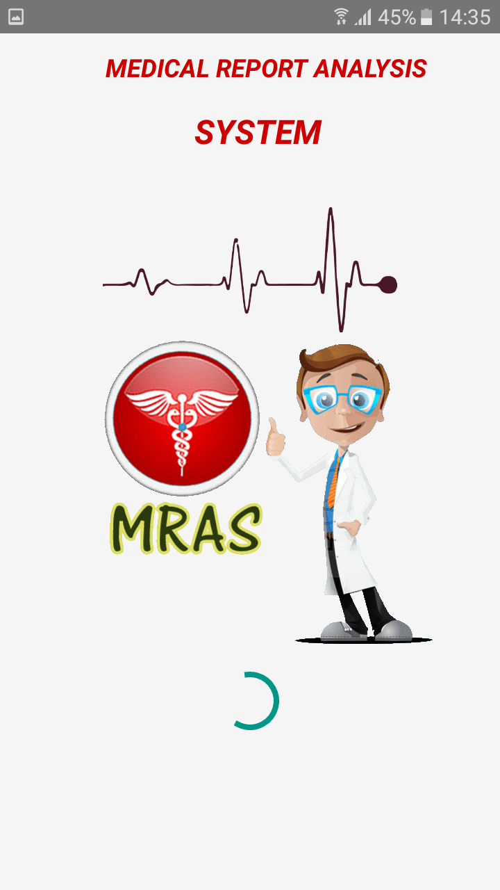
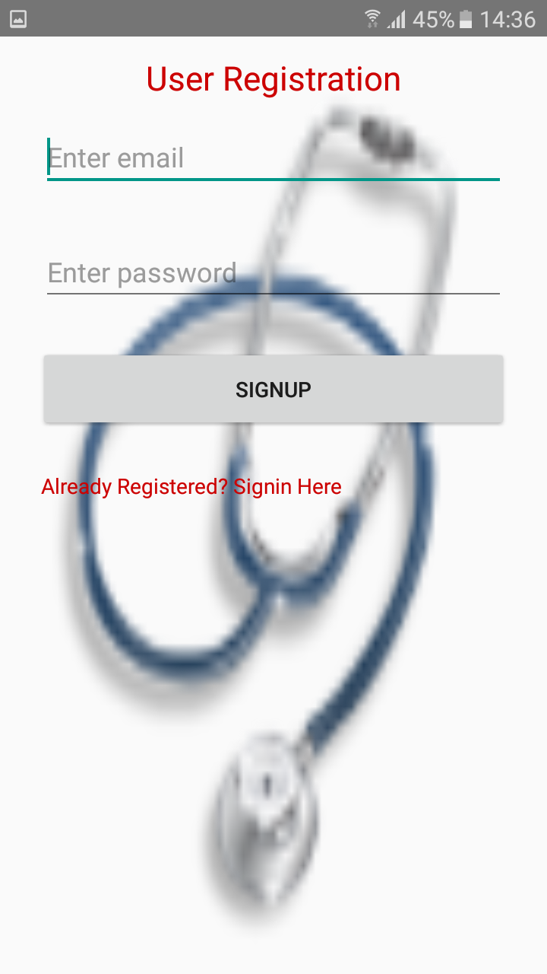

Slide 26
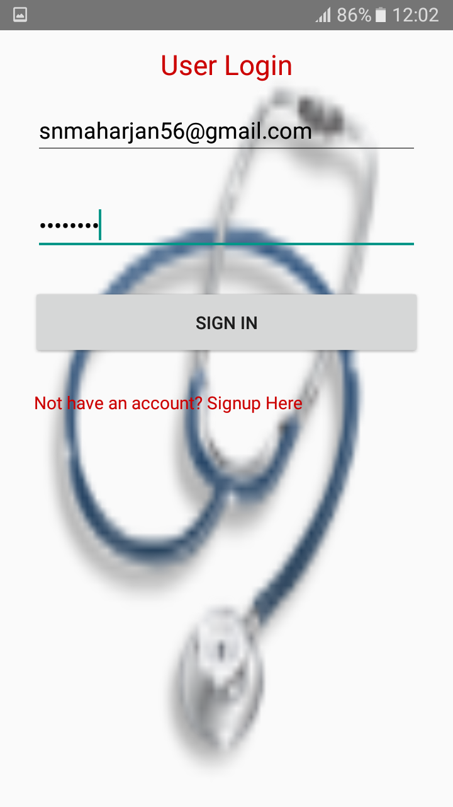
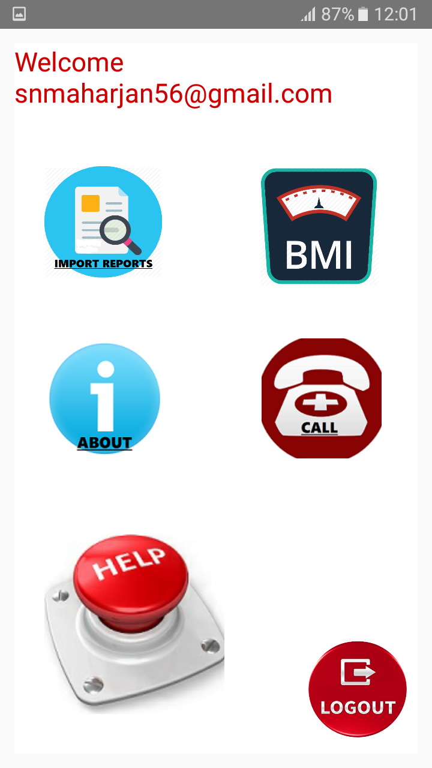

Slide 27
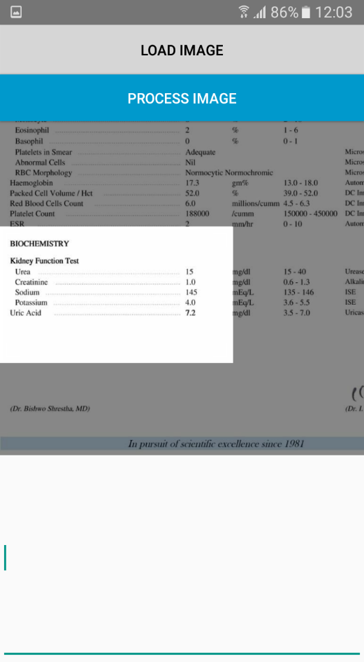
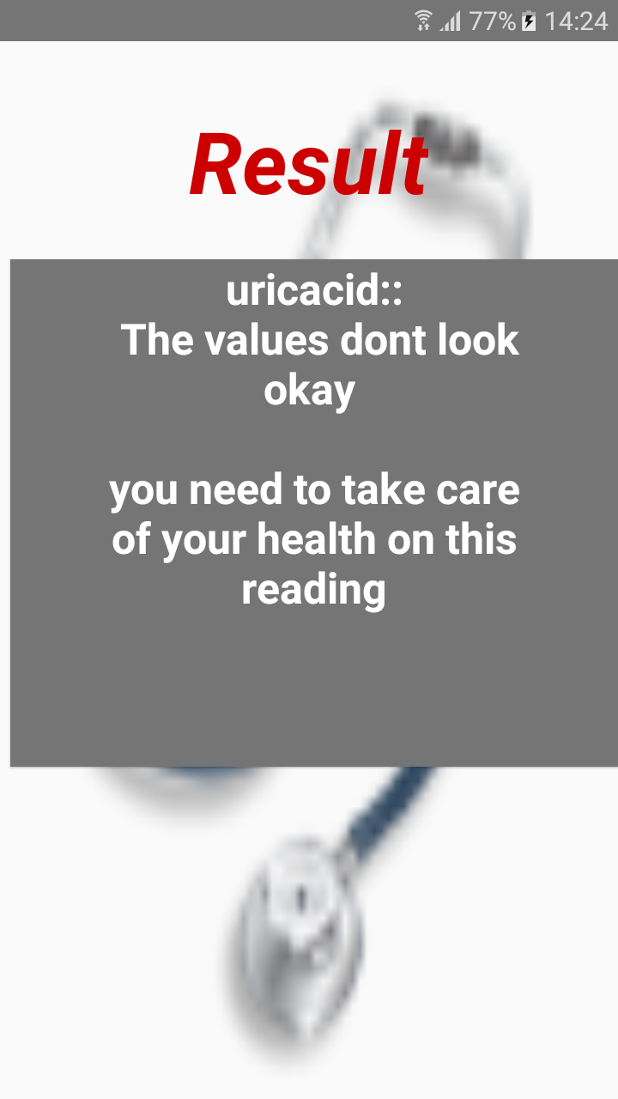

Slide 28
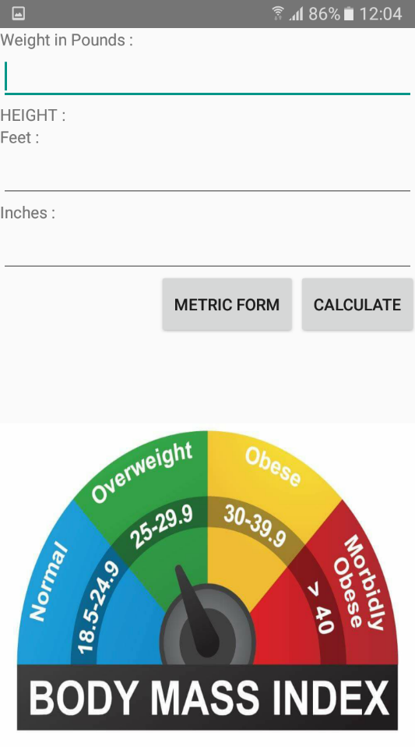
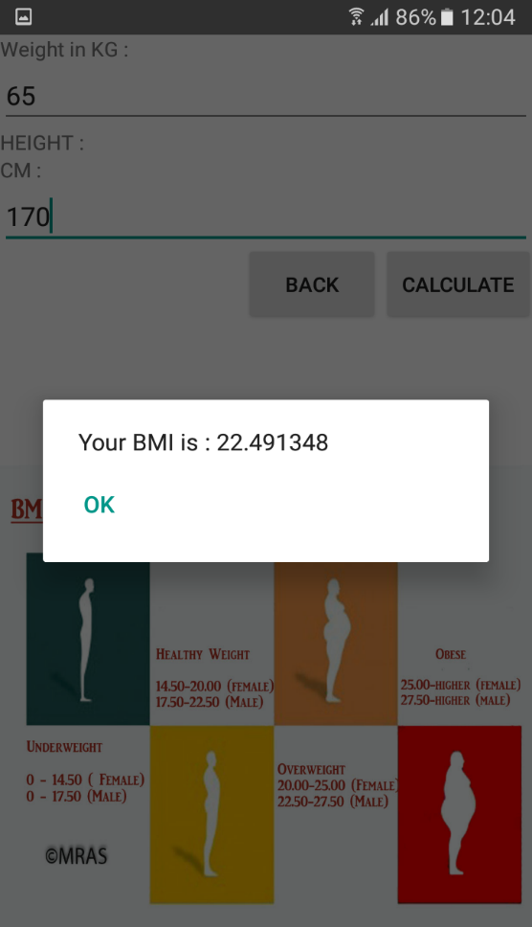

Slide 29
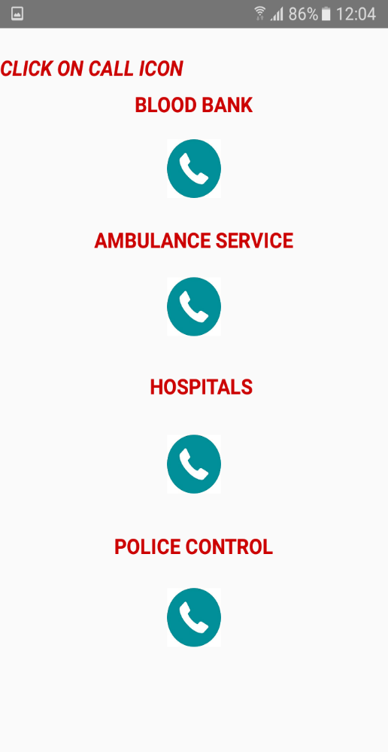
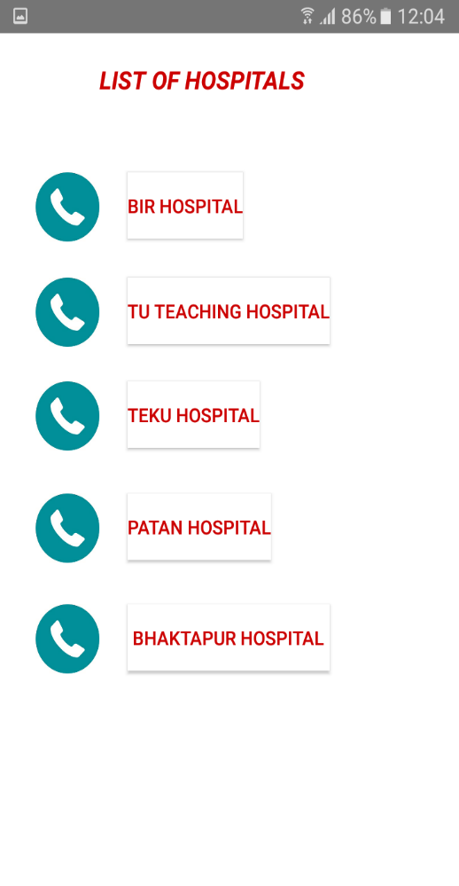

Slide 30
THANK YOU Any Queries???

